Slide 1
RTA Bus rides
BY Daniel Ledesma

Slide 2
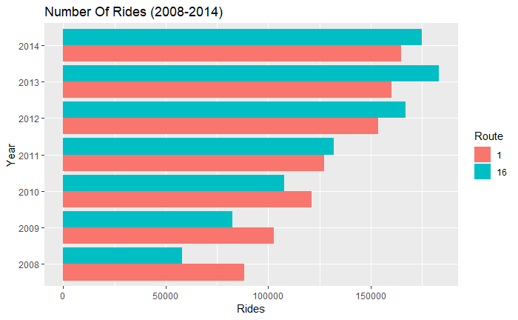
Total rides by ROUTE (2008-2014)
From 2008 to 2010 the numbers of rides for Route 1 was higher than Route 16
Until 2011, where the number of rides for Route 16 then surpassed those for Route 1

Slide 3
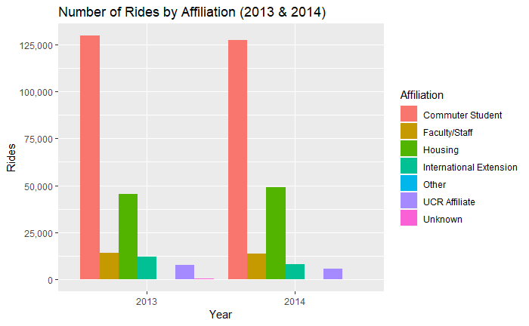
Total Rides by Affiliation (2013, 2014)
In 2013 and 2014, the affiliate with the highest number of rides was Commuter Students with over 120,000 rides
The second highest number of rides for both years were Housing Students, with nearly 50,000 rides
The affiliate with the highest change in rides was International/ Extension

Slide 4

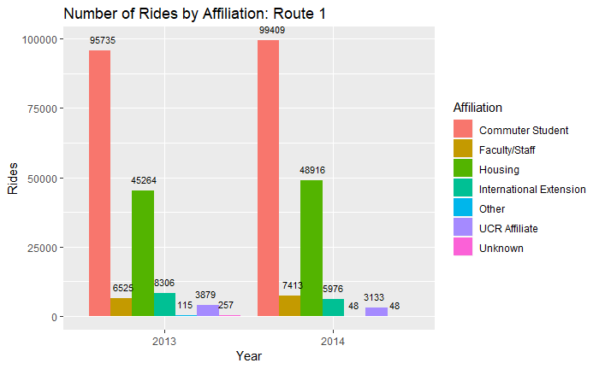
Total Rides by Affiliation (ROUTE 1)
For Route 1, the affiliate with the highest number of rides was Commuter Students
The amount of rides for Commuter Students and Housing increased in 2014, from the previous year, by about 4,000 rides
However, total rides for International/Extension decreased by about 2,000 rides

Slide 5
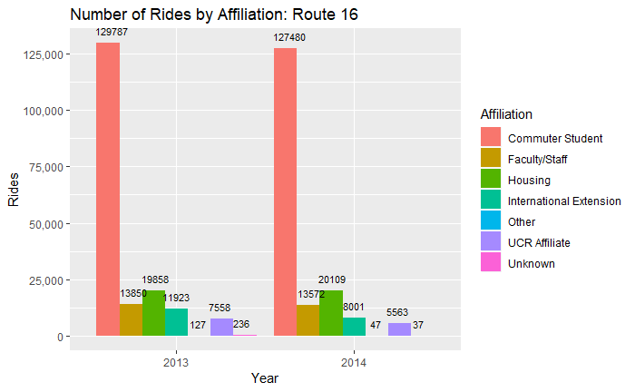
Total Rides by Affiliation (ROUTE 16)
For Route 16, the affiliate with the highest number of rides was Commuter Students, however the amount decreased in 2014, by about 2,000 rides
Total rides for Housing affiliates only increased by about a few hundred
However, total rides for International Extension affiliates decreased by 3,000

Slide 6
Comparing Total rides by affiliate between the two routes (2013,2014)
Route 16 had a higher number of total rides for Commuter Students for both years, by almost 35,000 rides
Route 1 had higher amount of total rides for Housing affiliates for both years by about 25,000 rides
The total rides for Faculty, UCR Affiliate and Other, was nearly double for Route 16, when compared to Route 1

Slide 7
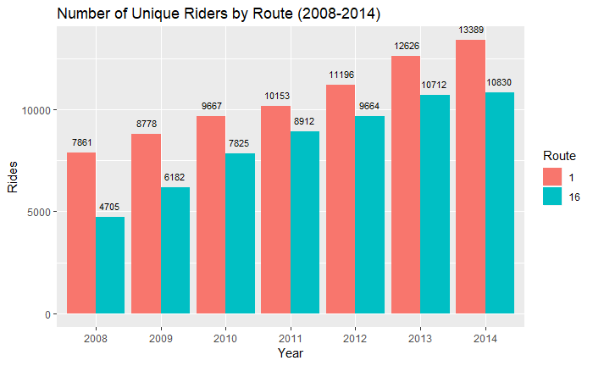
Unique riders by Route (2008-2015)
The number of unique riders, for both Routes, increased every year from 2008-2014
Route 1 had the most number of unique riders for the years 2008-2014

Slide 8
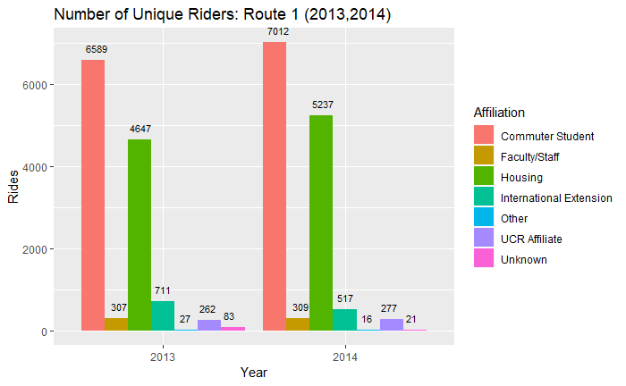
Unique Riders by Affiliation (route 1)
Commuter Students were the highest amount of the total unique riders for Route 1
Housing Students were also a big part of the total unique riders for Route 1
Unique Riders increased in 2014 for Commuter Students, Housing and UCR Affiliates

Slide 9
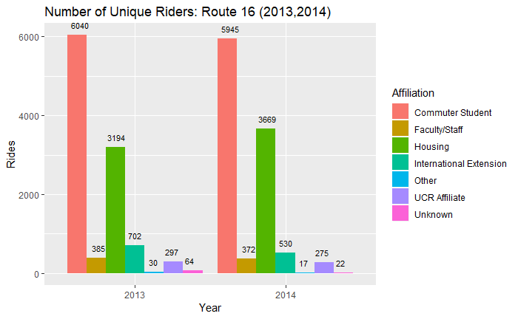
Unique Riders by Affiliation (route 16)
Commuter Students were the highest amount of the total unique riders for Route 16
Unique Riders increased in 2014 by about 500 for Housing affiliates

Slide 10
Comparing Unique Riders by Affiliation and routes
Route 16 had a higher proportion of unique riders who were Commuter Students in 2013 and 2014
Route 1 had a higher proportion of unique riders who were Housing Students in 2013 and 2014

Slide 11
Conclusion
Route 16 had a higher proportion of Commuter Students most likely due to Route 16 being from Moreno Valley Mall to UCR, which means that people who are taking that route live close to school and would rather take the bus than drive to school to avoid traffic in their car and waste more gas.
Route 1 had a higher proportion of Housing Students most likely due to the fact that housing students may not have their own form of transportation, so they use the bus to get around UCR and Downtown Riverside.

